Slide 1
Synthesis using Design Compiler with 0.13um Library
CSA & VLSI Lab.

Slide 2
Design : FIR_FILTER
Tool : Synopsys Design compiler
Library : IDEC 0.13um
Operation CLK : 40MHz
CSA & VLSI Lab.

Slide 3
Tcl_example
set top FIR_FILTER
set target_library /Tools/Library/SAMSUNG_0.13um/cellbased/SEC150E_SYNOPSYS/syn/std150e_typ_120_p025.db
set link_library /Tools/Library/SAMSUNG_0.13um/cellbased/SEC150E_SYNOPSYS/syn/std150e_typ_120_p025.db
set symbol_library /Tools/Library/SAMSUNG_0.13um/cellbased/SEC150E_SYNOPSYS/syn/std150e_veri.sdb
# you must check library path (in SUN29 Marchine)
read_verilog ../src/FIR_FILTER.v
analyze -format verilog ../src/FIR_FILTER.v
# must defined by your environment ( check the path again!!!)
current_design $top
link
uniquify
set_fix_multiple_port_nets -all -buffer_constants
CSA & VLSI Lab.

Slide 4
Tcl_example
## AREA ##
set_max_area 100000
## CLOCK ##
create_clock -period 25 [get_ports CLK]
set_clock_uncertainty -setup 0.5 [get_clocks CLK]
set_clock_latency -source 0.2 [get_clocks CLK]
set_clock_latency -max 0.1 [get_clocks CLK]
set_clock_transition 0.25 [get_clocks CLK]
set_dont_touch_network [get_clocks CLK]
## INPUT DELAY ##
set_input_delay -max 8 -clock CLK [all_inputs]
remove_input_delay [get_ports CLK]
## OUTPUT DELAY##
set_output_delay -max 8 -clock CLK [all_outputs]
## OUTPUT PORT LOAD ##
set_load 0.003 [all_outputs]
## INPUT PORT TRANSITION ##
set_input_transition 0.4 [all_inputs]
remove_driving_cell [get_ports CLK]
# Caution : check the CLK port name : it distinguish whether capital or not
# Must redefine your design stretegy
CSA & VLSI Lab.

Slide 5
Tcl_example
## MAX CAPACITANCE ##
set_max_capacitance 3 [all_designs]
## MAX TRANSITION and FANOUT ##
set_max_transition 0.55 [all_designs]
set_max_fanout 15 [all_designs]
## OPERATING CONDITIONS ##
set worst V165WTP1250
set best V195BTN0400
set typical V180TTP0250
# COMPILE #
compile -auto_ungroup delay -boundary -map_effort high
remove_unconnected_ports [find -hierarchy cell {*}] -blast_buses
current_design $top
report_port -verbose > ./log/$top.report_port_verbose.log
report_design > ./log/$top.report_design.log
report_constraint
report_constraint -verbose > ./log/$top.report_verbose.log
report_constraint -all_violators > ./log/$top.report_all_violators.log
report_timing -delay max > ./log/$top.report_delay_max.log
report_timing -delay min > ./log/$top.report_delay_min.log
report_area > ./log/$top.report_area.log
report_power > ./log/$top.report_power.log
report_clock > ./log/$top.report_clock.log
change_name -h -rule verilog > ./log/change_names.v
write -f verilog $top -h -o ./db/$top.v
write_sdf -version 1.0 ./db/$top.sdf
write_sdc ./db/$top.sdc
CSA & VLSI Lab.

Slide 6
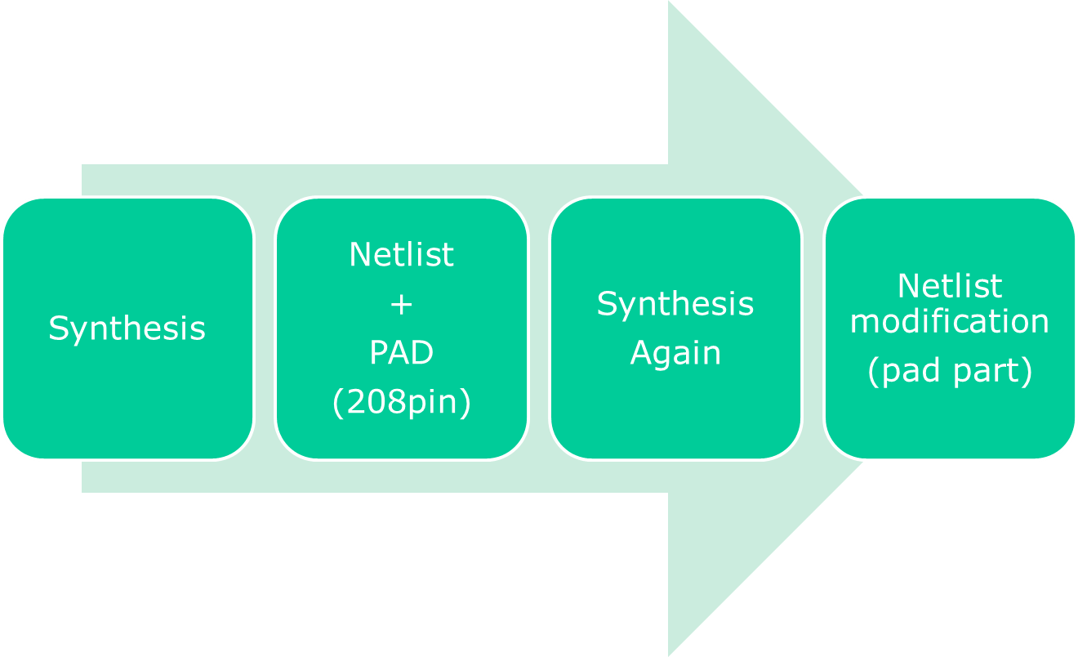
CSA & VLSI Lab.

Slide 7
_PAD module example
module FIR_FILTER_PAD ( RESET, CLK, WR, iDATA, oDATA );
input [15:0] iDATA;
output [38:0] oDATA;
input RESET, CLK, WR;
wire wRESET, wCLK, wWR;
wire [15:0] wiDATA;
wire [38:0] woDATA;
FIR_FILTER FIR1 ( .RESET(wRESET), .CLK(wCLK), .WR(wWR), .iDATA(wiDATA),
.oDATA(woDATA) );
vssoh pad1();
vssoh pad2();
vssoh pad3();
vssoh pad4();
phic pad33 ( .PAD(iDATA[0]), .PI(1'b0), .PO(), .Y(wiDATA[0]) );
phic pad34 ( .PAD(iDATA[1]), .PI(1'b0), .PO(), .Y(wiDATA[1]) );
phic pad35 ( .PAD(iDATA[2]), .PI(1'b0), .PO(), .Y(wiDATA[2]) );
phic pad36 ( .PAD(iDATA[3]), .PI(1'b0), .PO(), .Y(wiDATA[3]) );
// Given to you “ FIR_FILTER_PAD.v“
// Refer to the pdf file in the STD150_IO in the manual folder for more detailed info. about PAD cell
….
CSA & VLSI Lab.

Slide 8
Tcl_Example(syn. with pad)
set top FIR_FILTER_PAD
# check the top module name is set as _PAD module
set target_library /Tools/Library/SAMSUNG_0.13um/cellbased/SEC150E_SYNOPSYS/syn/std150e_typ_120_p025.db
set link_library /Tools/Library/SAMSUNG_0.13um/cellbased/SEC150E_SYNOPSYS/syn/std150e_typ_120_p025.db
set symbol_library /Tools/Library/SAMSUNG_0.13um/cellbased/SEC150E_SYNOPSYS/syn/std150e_veri.sdb
read_verilog ../src_pad/FIR_FILTER.v
read_verilog ../src_pad/FIR_FILTER_PAD_F.v
analyze -format verilog ../src_pad/FIR_FILTER.v
analyze -format verilog ../src_pad/FIR_FILTER_PAD_F.v
# synthesis with pad
current_design $top
link
uniquify
set_fix_multiple_port_nets -all -buffer_constants
….
CSA & VLSI Lab.

Slide 9
Tcl_Example(syn. with pad)
## AREA ##
set_max_area 100000
## CLOCK ##
create_clock -period 25 [get_ports CLK]
set_clock_uncertainty -setup 0.5 [get_clocks CLK]
set_clock_latency -source 0.2 [get_clocks CLK]
set_clock_latency -max 0.1 [get_clocks CLK]
set_clock_transition 0.25 [get_clocks CLK]
set_dont_touch_network [get_clocks CLK]
set_ideal_network [get_clocks CLK]
# Must insert this command !!!!!
-> After synthesis, it should be modified as the command : set_propagated_clock [get_clocks CLK] in the .SDC file
## INPUT DELAY ##
set_input_delay -max 8 -clock CLK [all_inputs]
remove_input_delay [get_ports CLK]
## OUTPUT DELAY##
set_output_delay -max 8 -clock CLK [all_outputs]
# the other constraint can be same as the initial synthesis, but it can also be changed depending on the designer’s strategy.
….
CSA & VLSI Lab.

Slide 10
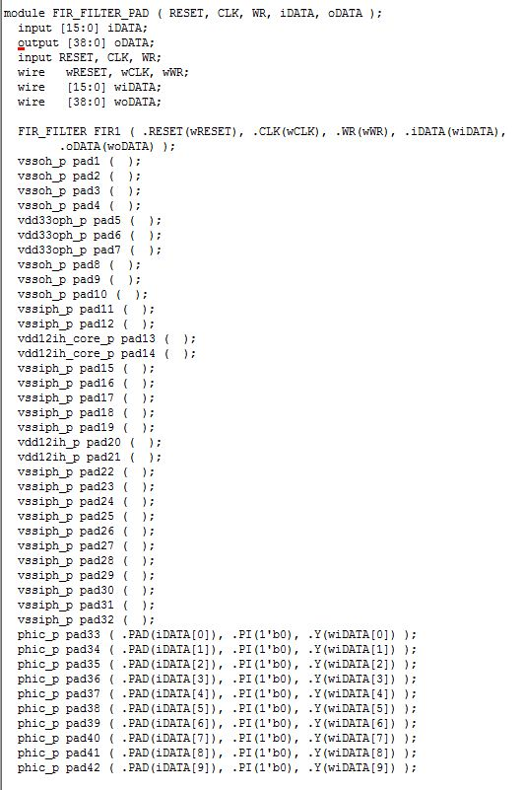
MUST : Pad cell reorganization
After synthesis,
intrinsic pad cell name
should be reorganized like
left figure (in the final netlist)
“_p“: must attach all the
pad cell name before the
P&R entered.
(otherwise, Astro will not
read your netlist.)
CSA & VLSI Lab.

Slide 11
VCS Library path for PRE/POST Simulation
/Tools/Library/SAMSUNG_0.13um/cellbased/SEC150E_VCS/verilog/STD150e.v
The Other VCS way to use are perfectly same.
Post Simulation for VCS is available when you use 0.13um
Library
CSA & VLSI Lab.

